Slide 1
Team Leads in a Tournament: Paper & Deck Check
Will Seymour & Ray Wat
Notes:
Introducing ourselves

Slide 2
What Do Team Leads Do
Team Leads – Report to the HJ *
- main responsibility is his team
- main communication between TO/HJ and the judge team/players

Slide 3
2 major team leading activities
- Paper
- Deck Check
Notes:
Some would argue that Logistic is a third one, a lot of tournaments merge this with one or both of the teams. It is more so relevant in Limited.

Slide 4
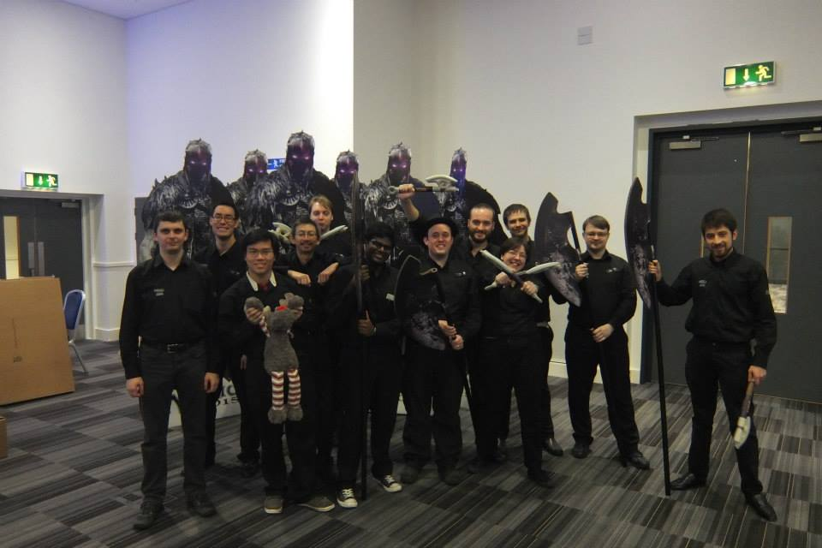
Team

Slide 5

Papers, please!

Slide 6
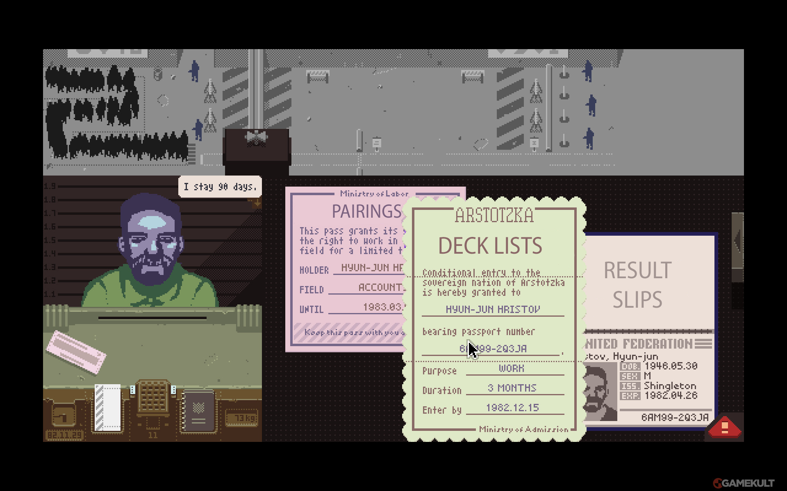

Slide 7
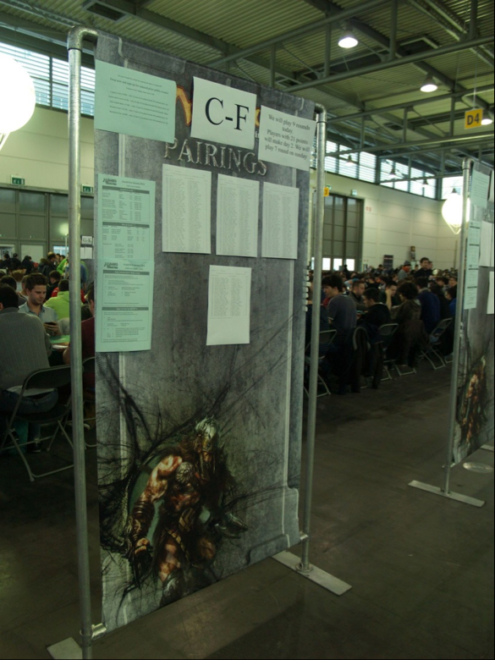
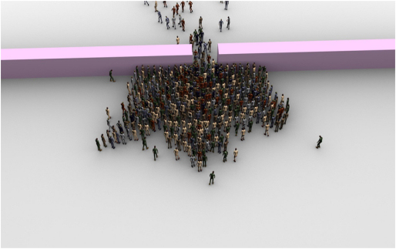
08:00 – Setting Up
Pairing boards placed far enough apart
Boards out of the way of bottlenecks
Think through every step in advance

Slide 8
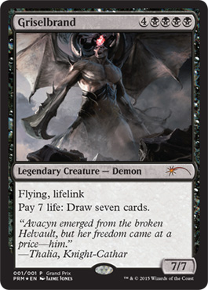
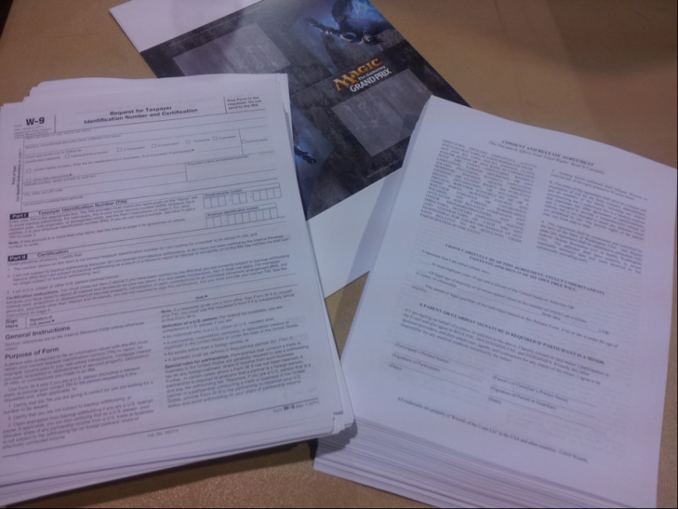
08:00 – Setting Up
Decklists, product, [foils], [waivers] ready
Piled by table size and location in the venue
Tasks delegated in advance!

Slide 9


Slide 10
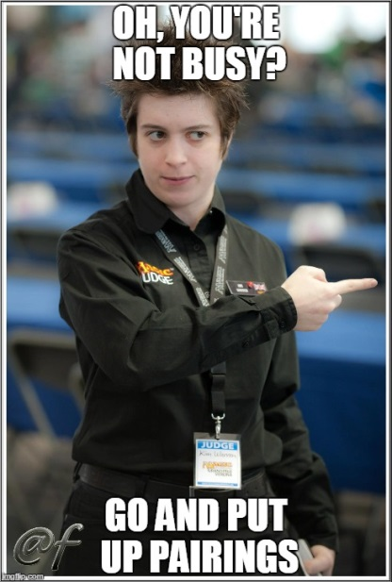
09:00 – Tournament Begins
Get a seat all for papers & deck checks!
Distribute sheets between team members
Try and have papers collected in order
Give pairings out to team members as soon as they are ready

Slide 11
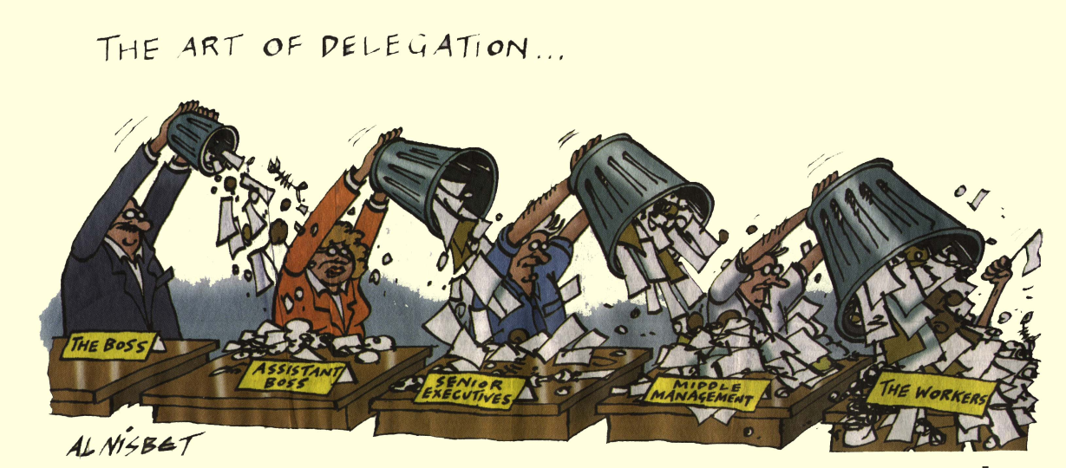
09:30 – Mid round 1
Get results slips printed
If you’re printing them yourself, use the cutting machine feature in WER
Get slips cut and distributed – ask other judges for help with this!

Slide 12
10:00 – End of round 1
Talk to the scorekeeper about how they want result slips (e.g. ordered)
Other judges should be watching tables by now – make sure they haven’t started hoarding result slips
Keep track of outstanding tables, and note down who you sent to each table
Track down missing results using the PA

Slide 13
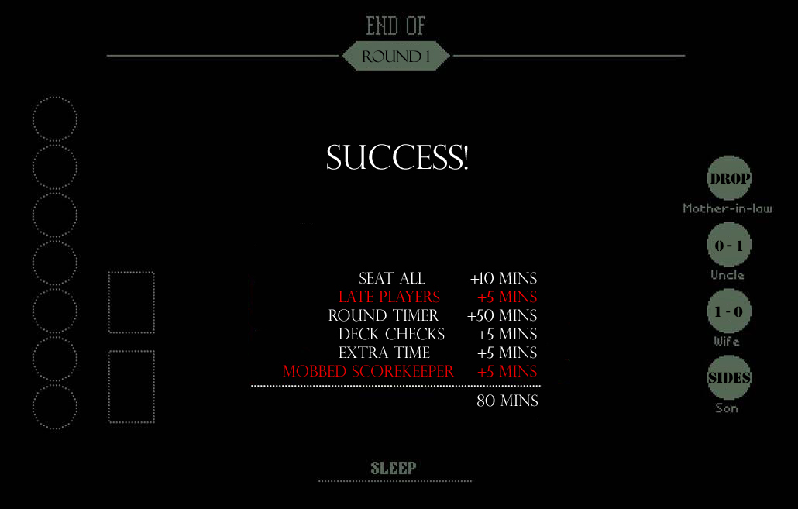

Slide 14
Deck Check
This is mainly for Constructed Tournament, but majority of the points should be applicable to Limited too.
Talk to the HJ before hand and discuss what you will need him/her to say during the Players’ Meeting.
Such as.........

Slide 15
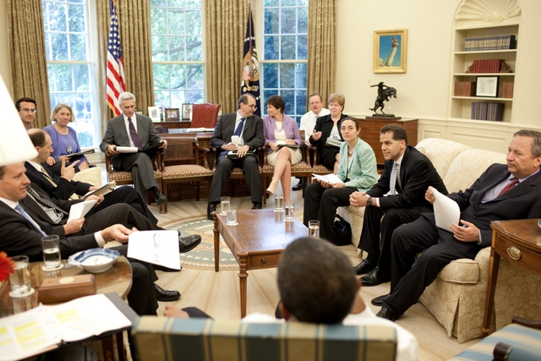
Players’ Meeting

Slide 16
a) alphabetically arrangement
b) table number on decklists
c) Instruct the judges who are collecting decklists how you wish them to be collected.

Slide 17
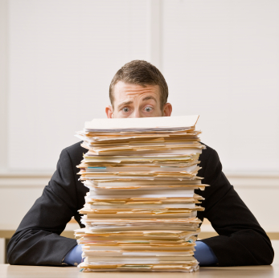
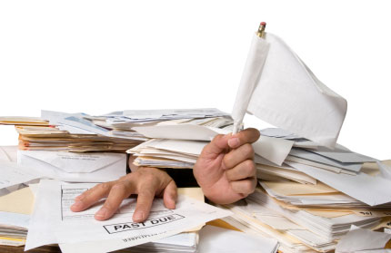
Tips
1) Master copy.
2) Beware of late comers
3) Separate the decklists in a number of piles for easy searching.

Slide 18
4) When taking decklists out of a pile, colour coding
5) 7 mins limit & how
6) Is there a target number of checks?

Slide 19
7) picking decks up, ask who’s who.
8) When mid round DC, the result slips
9) If there are enough judges on the floor, do other things. Top 8

Slide 20
Recap
1) Delegate tasks early, for the whole day
2) Think through each step in advance
3) Catch up every round
4) Communicate with your judges clearly
5) Anything that make life easier, do it

Slide 21

Conclusion
Preparation is the key
Communication is the key
Learning is the key

